Slide 1
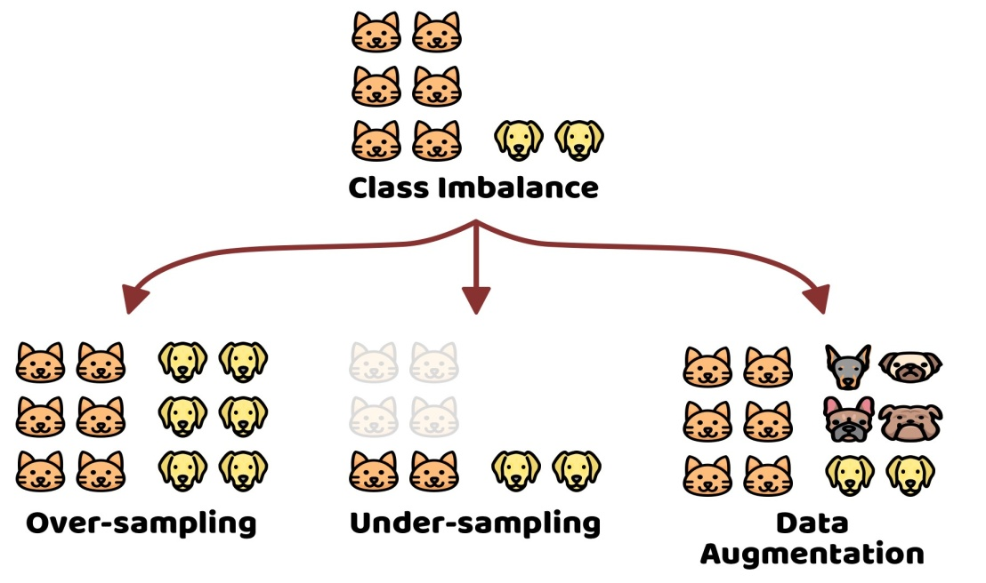


Improving model performance & removing the class imbalance problem using Augmentation
Allena Venkata
Sai Abhishek
MTech Data Science
GITAM University, Visakhapatnam, India
PROJECT REVIEW- 2020-2022 ADMITTED BATCH
Department of Computer Science & Engineering
Allena Venkata Sai Abhishek -122021601009

Slide 2
What is Class Imbalance Problem?
Unequally distributed (Major & Minor Class)
Types of Class Imbalance
Slight Imbalance (<1:10)
Severe Imbalance (>1:10)
Solution for removing Class Imbalance Problem
Over-Sampling
Under-Sampling

Slide 3
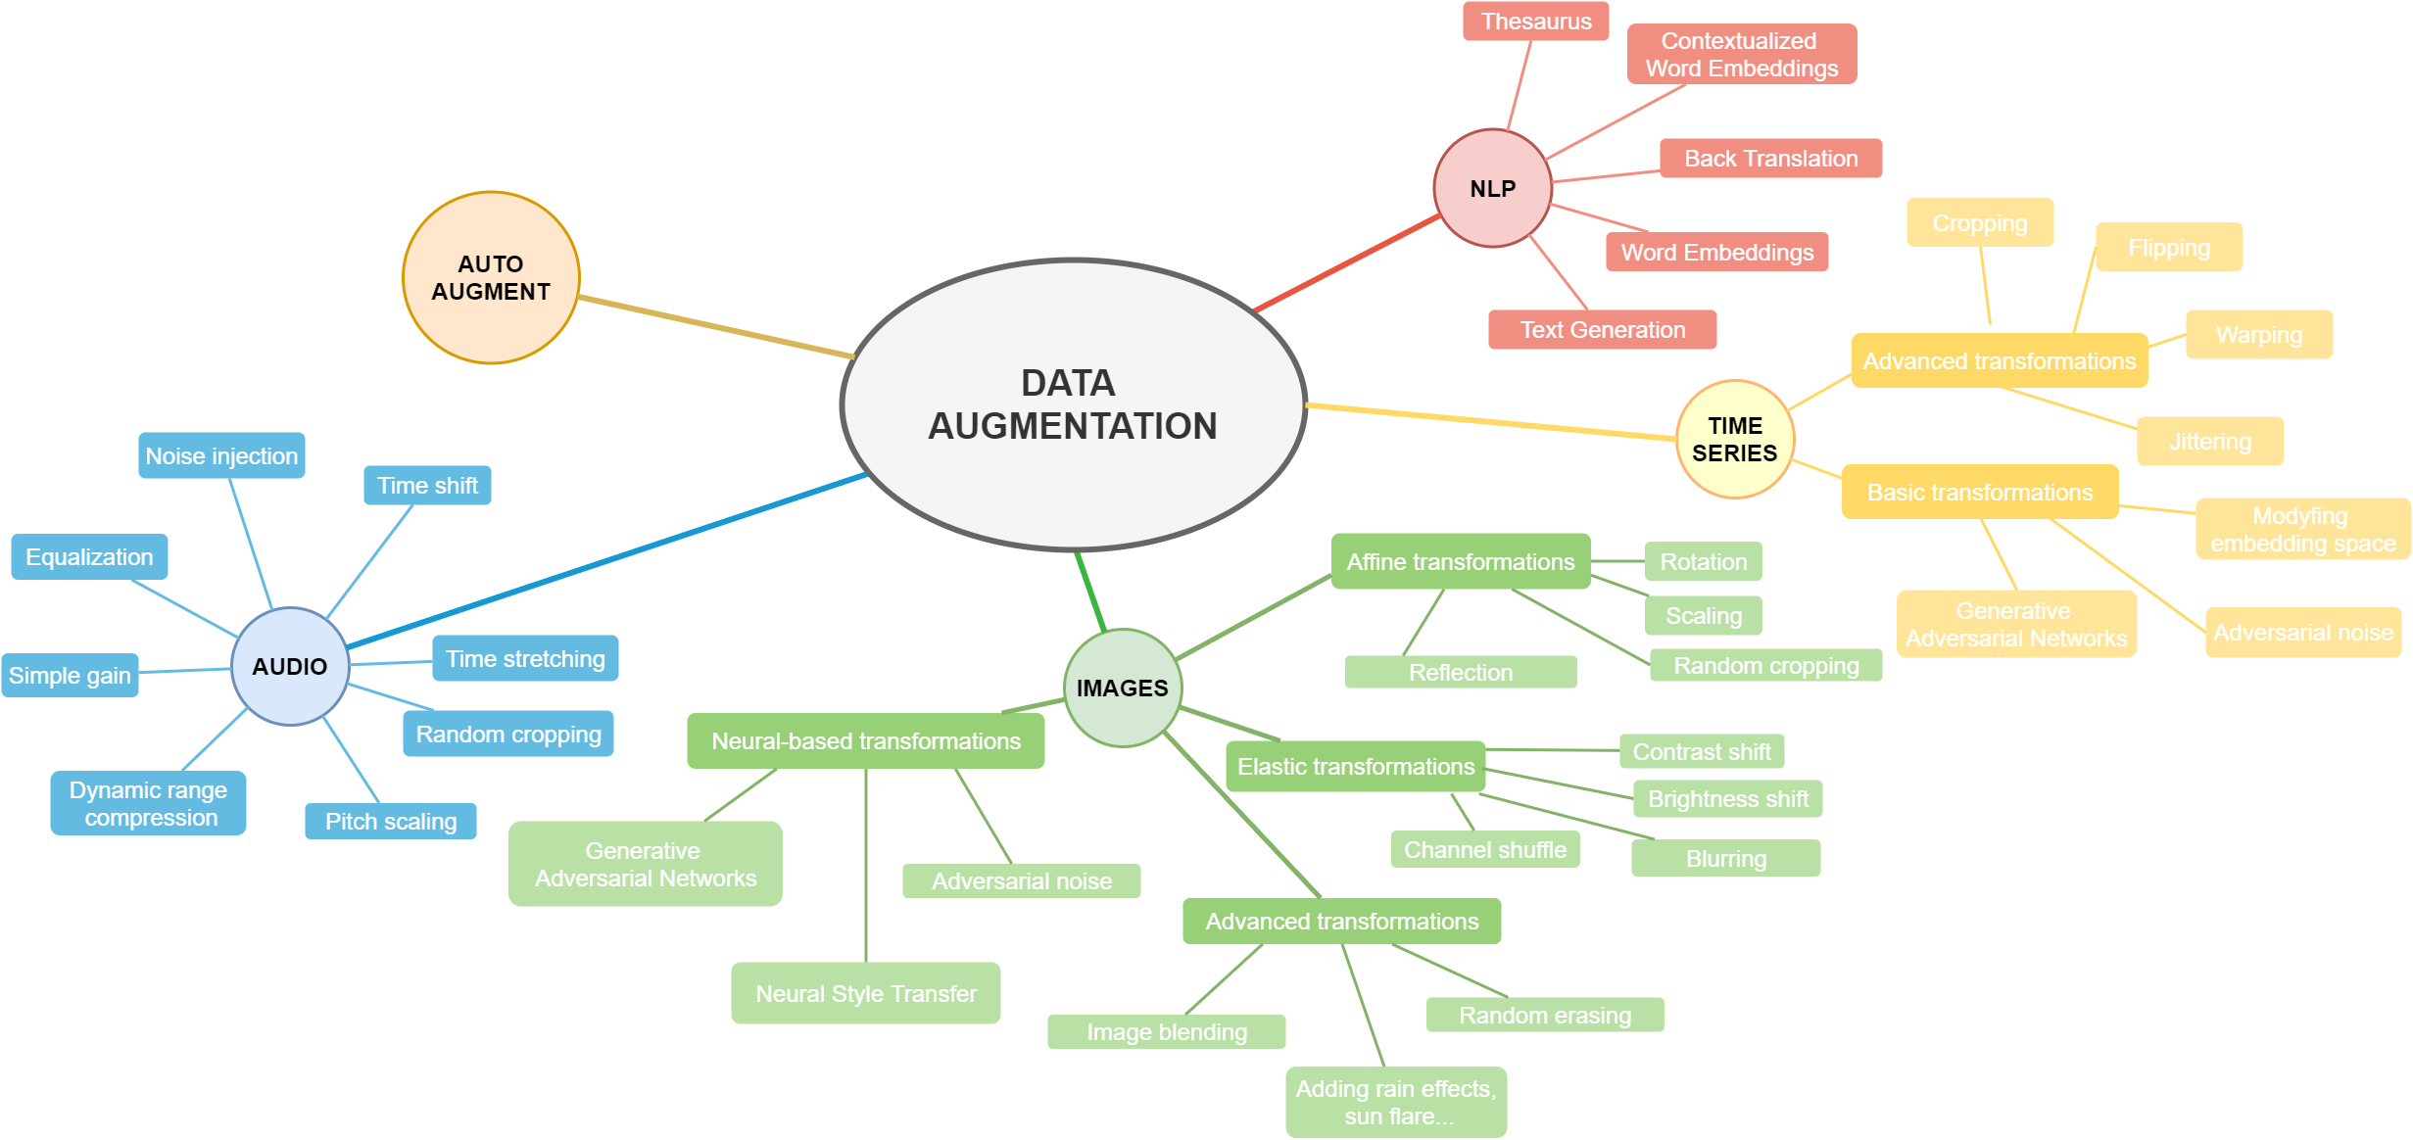
What is Augmentation?
Data augmentation is a technique to artificially create new training data from existing training data.
Data augmentation is a strategy that enables to significantly increase the diversity of data available for training models, without actually collecting new data.

Slide 4
Motivation Behind the Topic
The class imbalance problem is a painful feature in real world data
Many augmentations supported by various augmentation libraries

Slide 5
LITERATURE SURVEY
 | Journal Type and year | Authors | Title | Summary
1 | IEEE, 2017 | Mateusz Buda, Atsuto Maki, Maciej A. Mazurowski | A systematic study of the class imbalance problem in convolutional neural networks | As opposed to some classical machine learning models, oversampling does not cause overfitting of CNNs
2 | IEEE, 2015 | Kaiming He, Xiangyu Zhang, Shaoqing Ren, Jian Sun | Deep Residual Learning for Image Recognition | residual networks are easier to optimize, and can gain accuracy from considerably increased depth.
3 | IEEE, 2019 | Connor Taghi M. Khoshgoftaar | A survey on Image Data Augmentation for Deep Learning | Comparative study of various augmentation techniques
4 | IEEE, 2020 | Wanwan Zheng Mingzhe Jin | The Effects of Class Imbalance and Training Data Size on Classifer Learning | naïve Bayes, logistic regression model are less susceptible to class imbalance while they have relatively poor predictive performance
5 | IEEE, 2017 | Marcus D. Bloice, Christof Stocker, Andreas Holzinger | Augmentor: An Image Augmentation Library for Machine Learning | Augmentor makes it easier to perform artificial data generation, by providing a stochastic, pipeline-based API that allows for fine-grained control over the creation of augmented data and provides many functions for augmentation technique.

Slide 6
 | Journal Type and year | Authors | Title | Summary
6 | IEEE, 2018 | Alexandr A. Kalinin, Vladimir I. Iglovikov, Eugene Khvedchenya, Alex Parinov, Alexander Buslaev | Albumentations: fast and flexible image augmentations | A fast and flexible library for image augmentations with many various image transform operations available, that is also an easy-to-use wrapper around other augmentation libraries
7 | IEEE, 2018 | Hongyi Zhang, Moustapha Cisse, Yann N. Dauphin, David Lopez-Paz | MixUp augmentation for image classification | mixup trains a neural network on convex combinations of pairs of examples and their labels. Turn on screen reader support
8 | IEEE, 2019 | Zhiting Hu, Bowen Tan, Ruslan Salakhutdinov, Tom Mitchell, Eric P. Xing | Learning Data Manipulation for Augmentation and Weighting | the resulting algorithms significantly improve the image and text classification performance in low data regime and class-imbalance problems.
9 | IEEE, 2021 | Shanchuan Lin, Linjie Yang, Imran Saleemi, Soumyadip Sengupta | Robust High-Resolution Video Matting with Temporal Guidance | Input is downsampled for the encoder-decoder network, consists of an encoder that extracts individual frame’s features, a recurrent decoder that aggregates temporal information, Deep Guided Filter module for high-resolution upsampling. Then DGF is used to upsample result.
10 | Springer, 2021 | Xu Sun, Huihui Fang Yehui Yang, Dongwei Zhu Lei Wang, Junwei Liu Yanwu Xu | Robust Retinal Vessel Segmentation from a Data Augmentation Perspective | Data augmentation modules, namely, channel-wise random Gamma correction (correction on each channel) and channel-wise random vessel augmentation. (Morphological transformations on fine grained vessels.)
Click me for some more info
Also in next page too

Slide 7
Abstract
One particularly painful feature of real-world data is that it can be imbalanced. An imbalanced dataset is a dataset where there are many more datapoints for one category than others.
This research presents the Solving Class Imbalance problems using Random Sampling & Data Augmentation Techniques. Readers will understand how Under-Sampling, Over-Sampling, Synthetic Minority Over-sampling Technique & Data Augmentation using Image and custom datasets.
The model performance is being improved with the removing the class imbalance problem using various Augmentation approaches by building a custom Augmented Dataset generator & a Custom Augmentation library
The parameters on which the techniques will be compared are on accuracy to solve the Class imbalance problem to maximize accuracy and reduce error & find the best possible method to solve it.

Slide 8
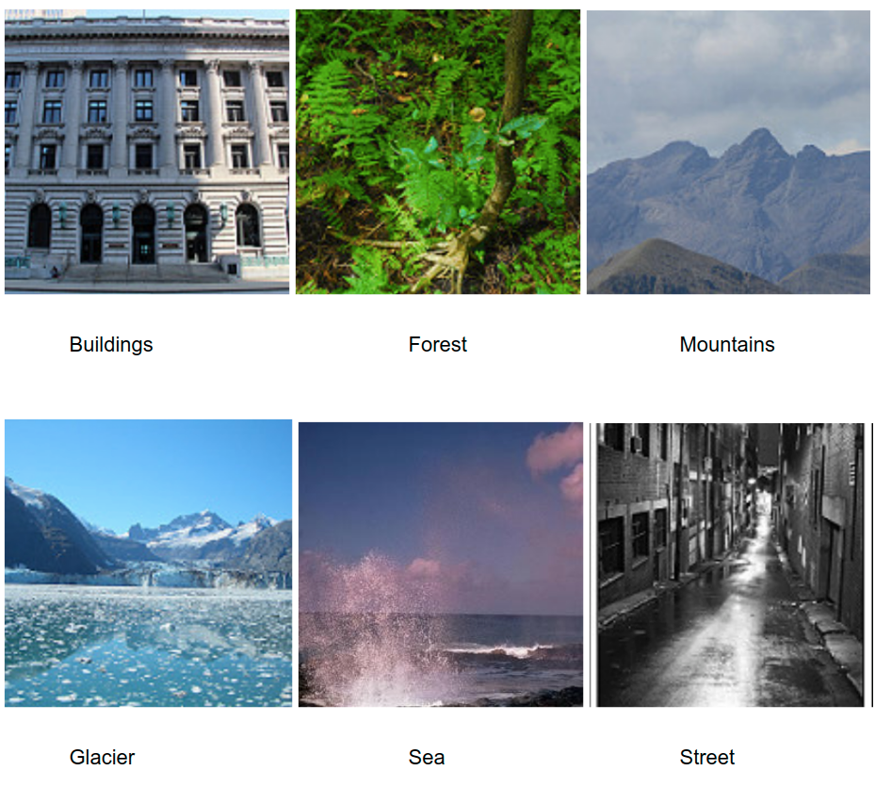
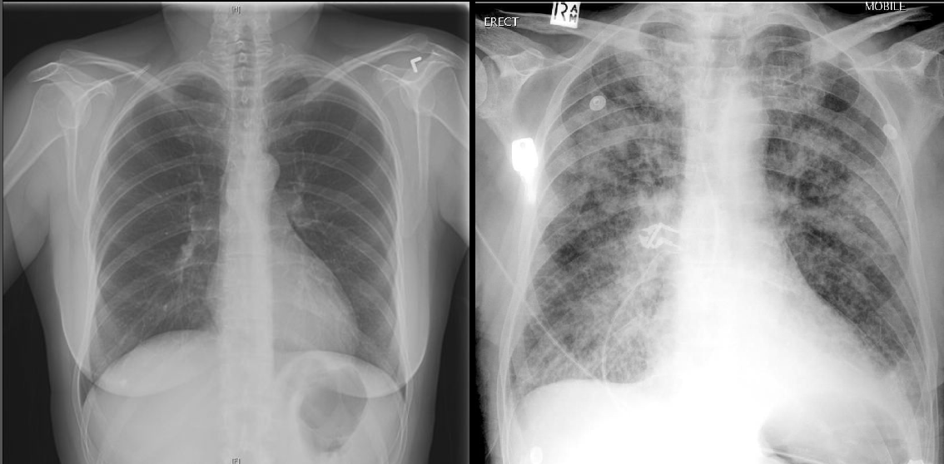
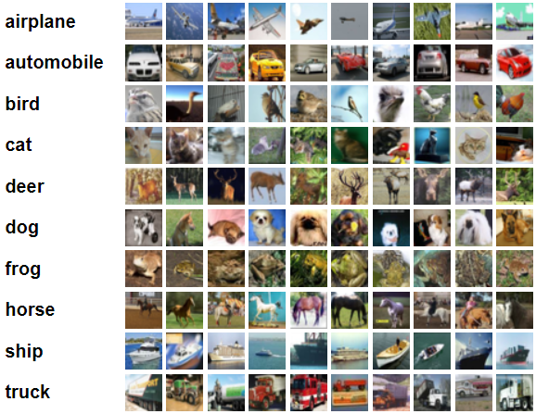
Dataset : An Image Classification Dataset (Intel Scenery), Chest Xray Pneumonia, CIFAR 10
Proposed System
Model : Resnet18
Solution :
Techniques implemented to solve class imbalance -
Under Sampling –
Random Under Sampling
Over Sampling –
Random Over Sampling,
Data Augmentation
Metric used to Compare : Accuracy
Goal : Find the best Data augmentation technique for the dataset with construction of augmentation library & augmented dataset generator

Slide 9
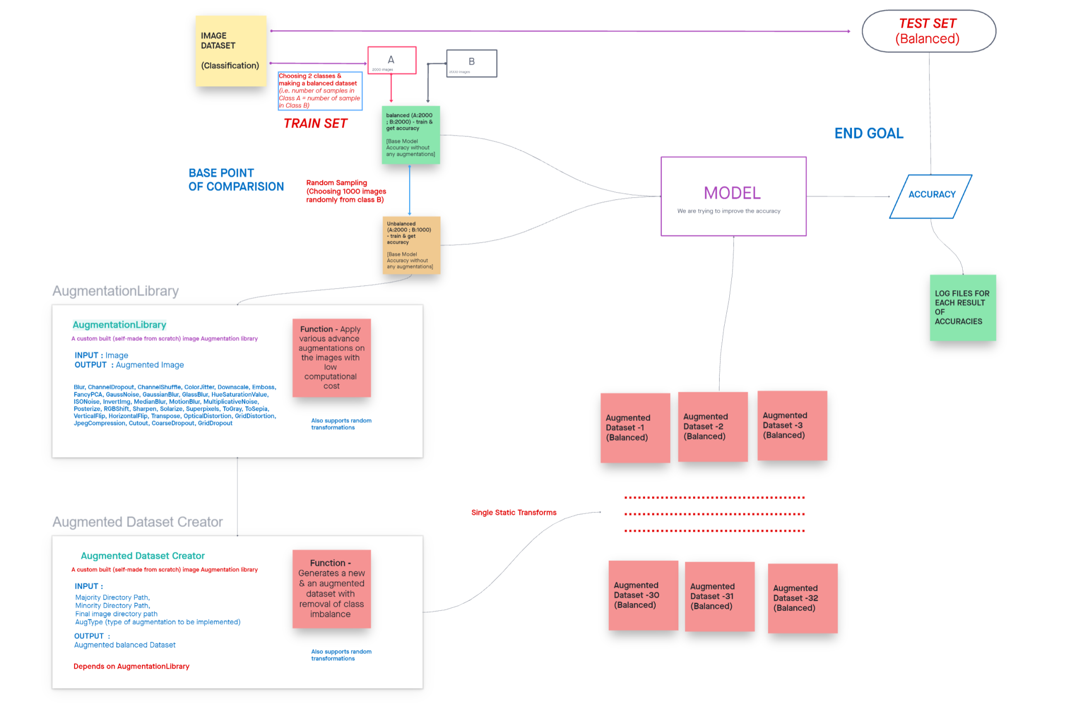
A Video Explanation of the workflow
Workflow of the Proposed System

Slide 10
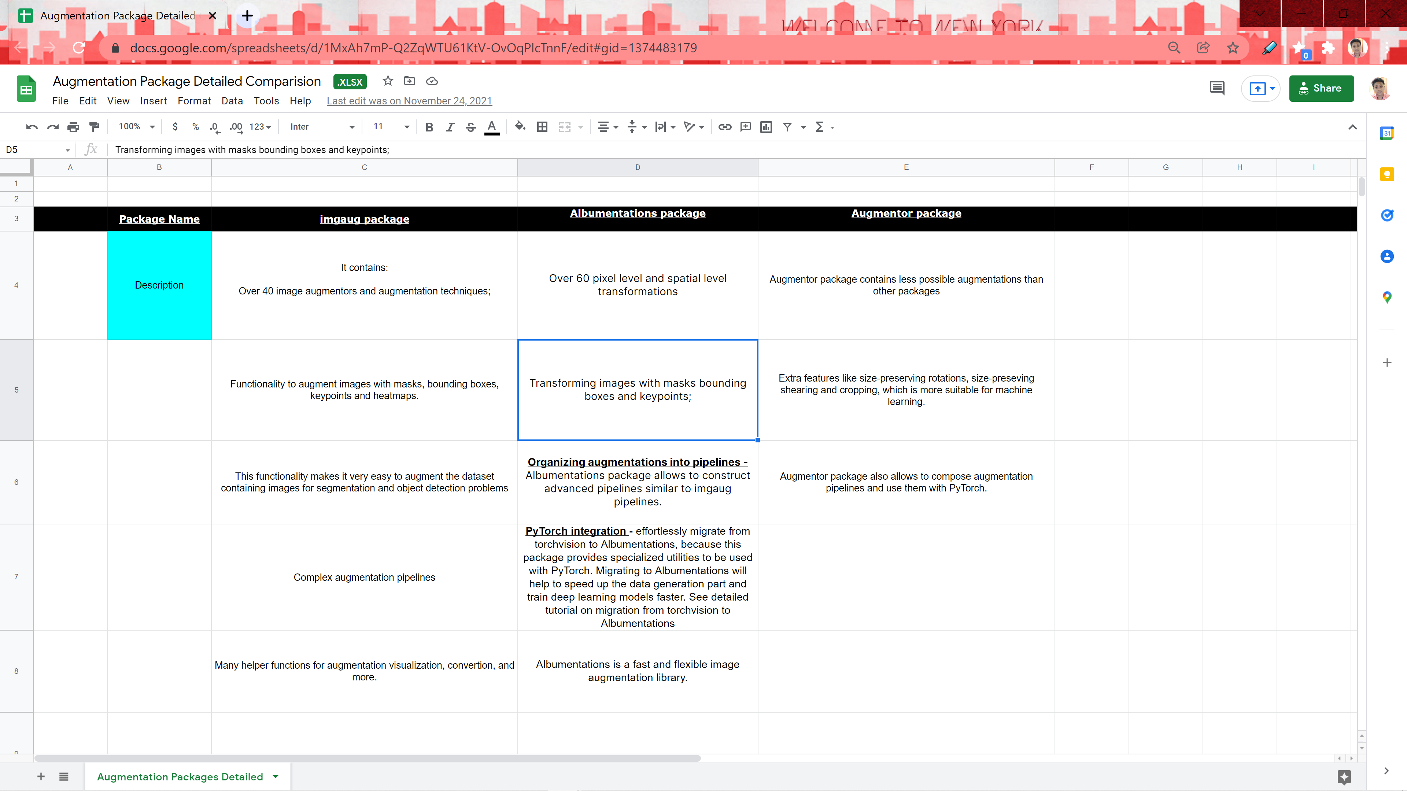
Augmentation LibrarIES

Slide 11
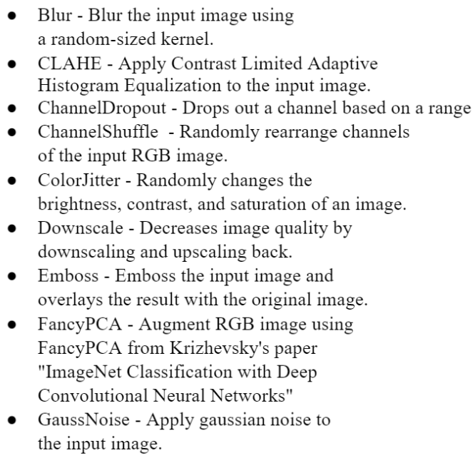
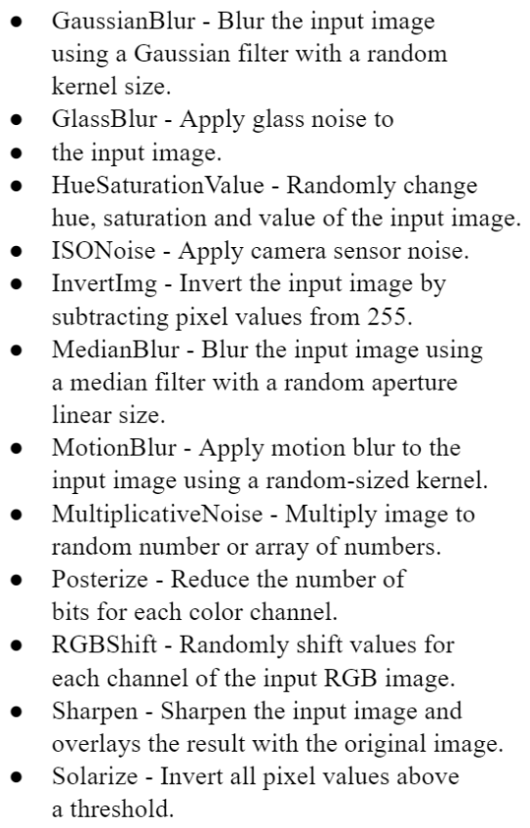
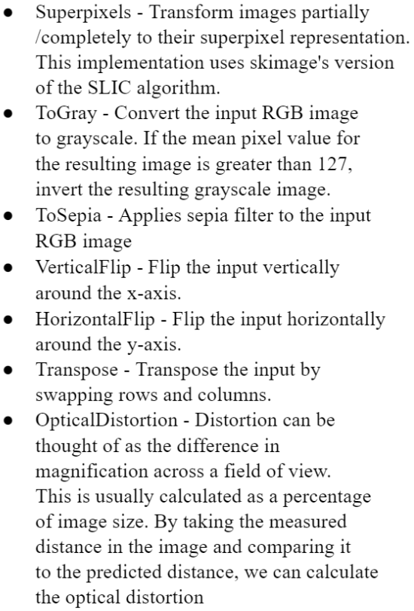
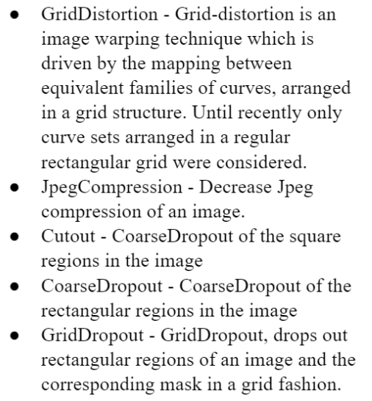
Augmentation Techniques

Slide 12
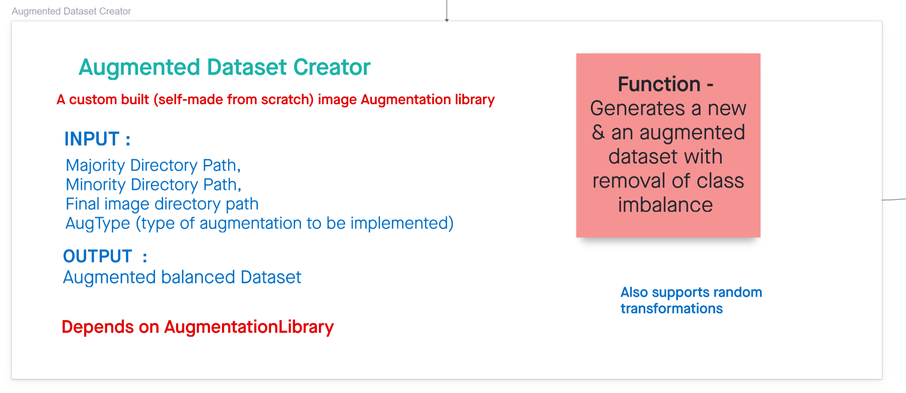
Augmentation Dataset Creator

Slide 13
model used & Architecture
model used & Architecture
RESNET18
X is input, Y is output , Y=F(X). The logic behind RESNET is to make Input=Output
If we make F(X)=0, then it is easy for us to make input = output Y=F(X)+X Y=X+0 Y=X
In normal networks we learn from Y but in Residual network we learn from F(X) and our target is to make F(X)=0 then only we can make input=output
RESNET 1st introduced the concept of skip connection.
Here, we add the original input to the output of the convolutional block
It has 18 layers

Slide 14
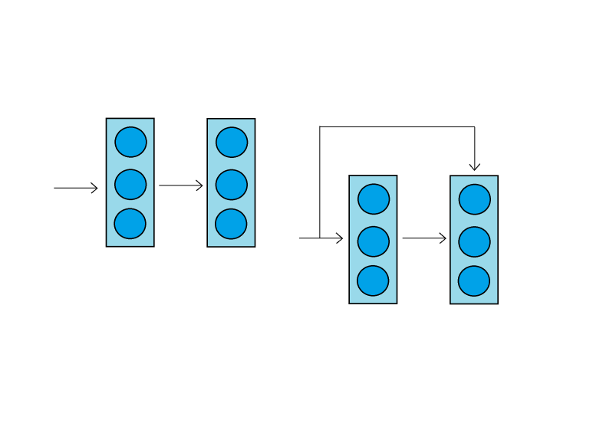
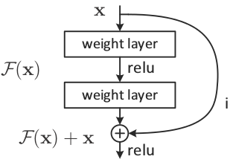
SKIP CONNECTION
Why is the relu applied after adding the skip connection?
If we had performed relu before addition, then the residues will all be positives or zero. Only positive increments to the identity are learnt, which significantly reduces the learning capacity.
For example in the sin function, sin(3π/2) = -1, which would need negative residue.
Similarly, using sigmoid will also be disadvantageous, because it produces residues only within 0 to 1.
===============================================================
Why are there two weight layers in one residual block?
if we had used a single weight layer, adding skip connection before relu, gives F(x) = Wx+x, which is a simple linear function.
This is equivalent to just a single weight layer and there is no point in adding skip connection.
So we need at least one non-linearity before adding skip connection, which is achieved by using two layers.

Slide 15
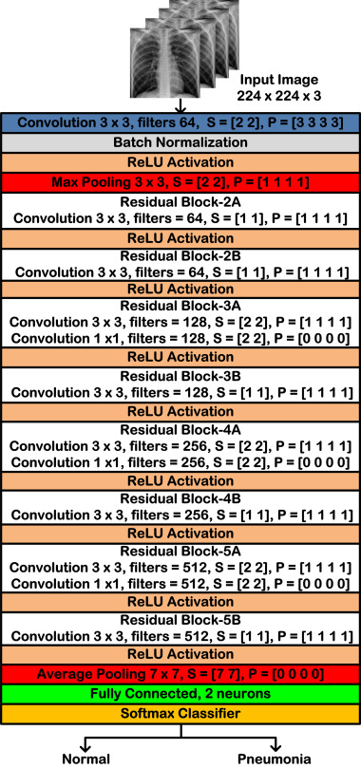
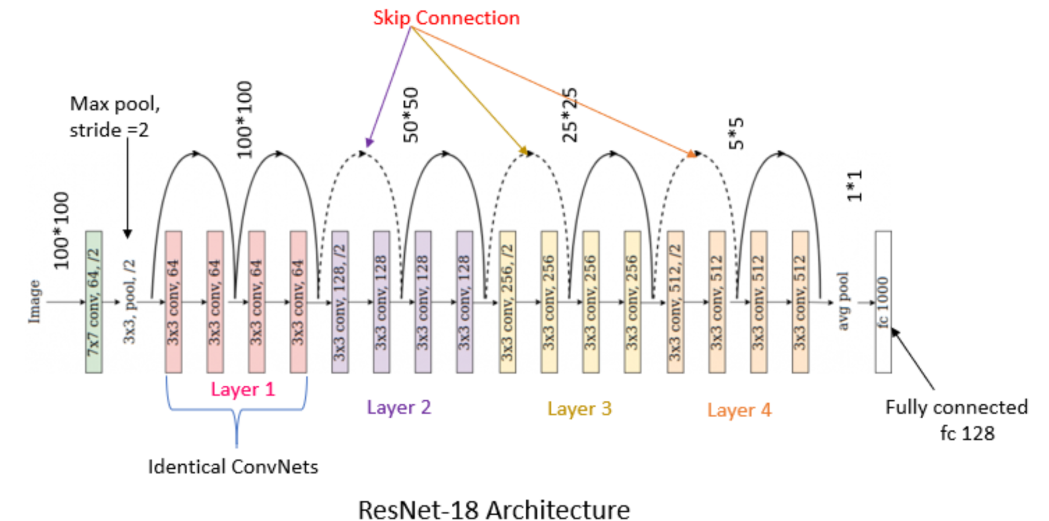
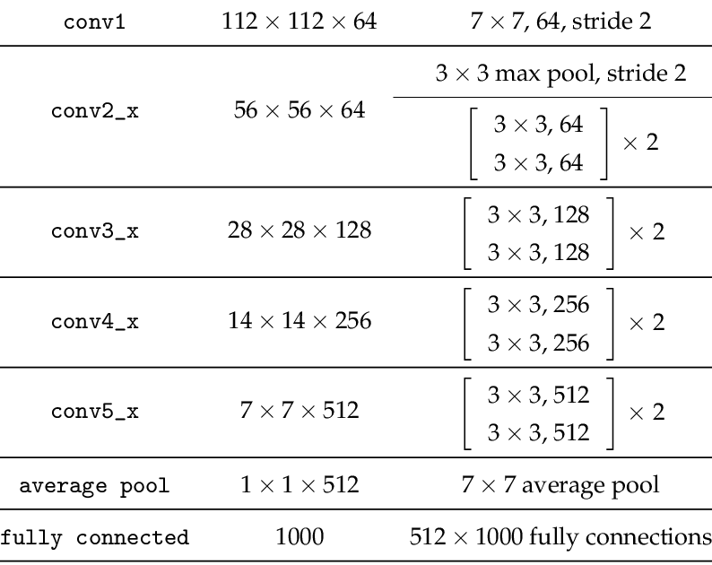


Slide 16
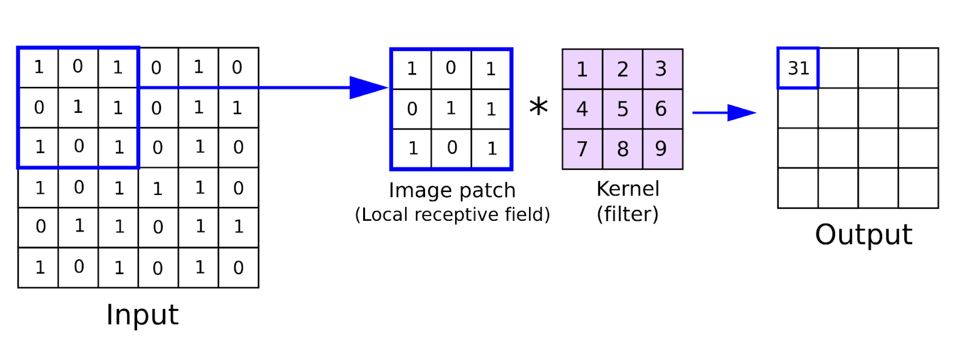
Convolution Operation
We do elementwise multiplication using a kernel on the input image & it is used for feature extraction.

Slide 17
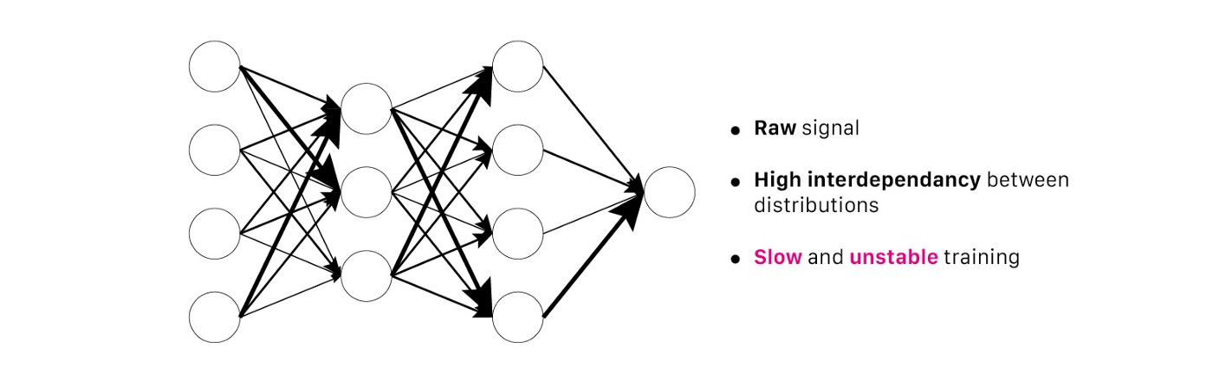
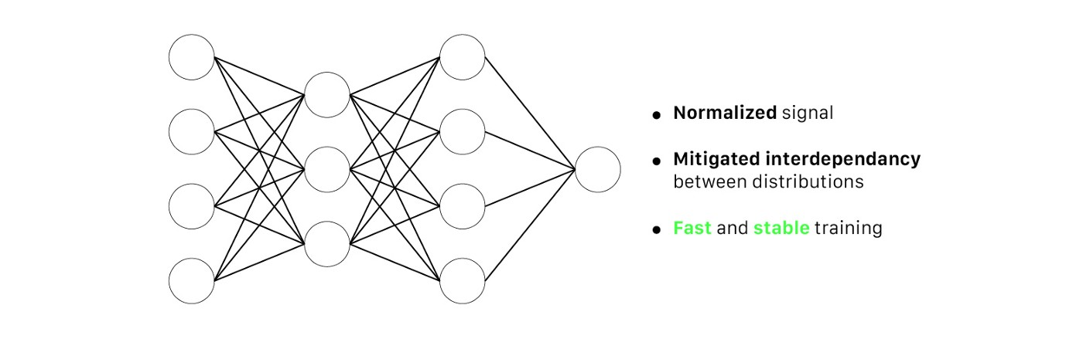
BATCH NORMALIZATION
For training very deep neural networks
the network to do learning more independently.
normalize the output of the previous layers before passing them on as the input of the next hidden layer.
Stabilizes the learning process
Reduces the number of training epochs required to train deep networks.

Slide 18

RELU ACTIVATION

Slide 19
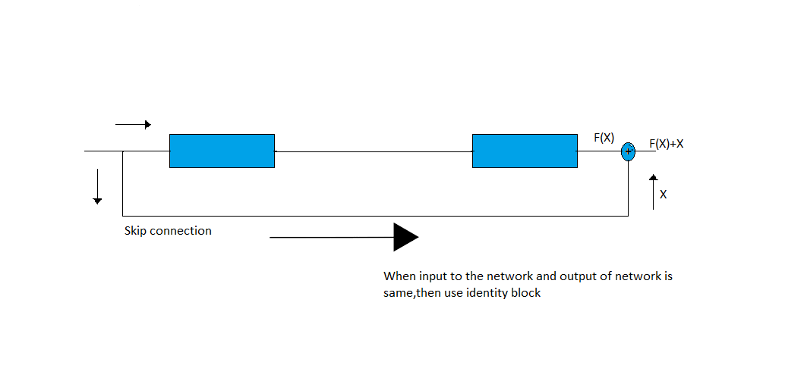
IDENTITY BLOCK
( INPUT SIZE = OUTPUT SIZE )

Slide 20
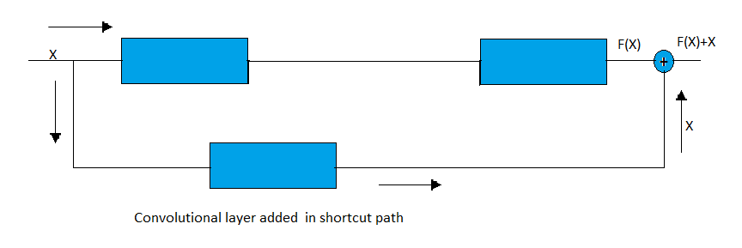
CONVOLUTIONAL BLOCK
( INPUT SIZE != OUTPUT SIZE )

Slide 21

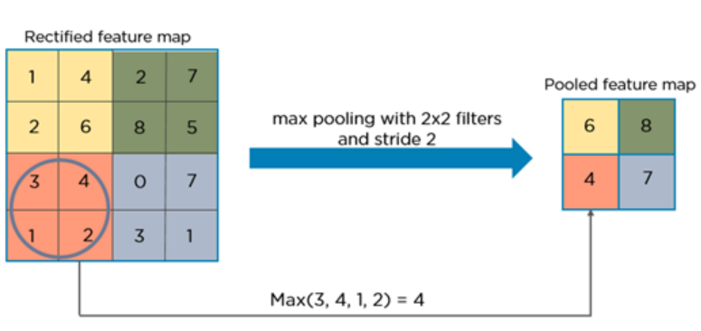
Pooling Operation
Pooling reduces the size of the feature map in order to help us with using the fewer parameters in the network i.e dimensionality reduction.
Used to find the essence.
3 types –
Min - Pixel with Minimum value is selected
Max – Pixel with Maximum value is selected
Average – Average of the pixel value is taken

Slide 22
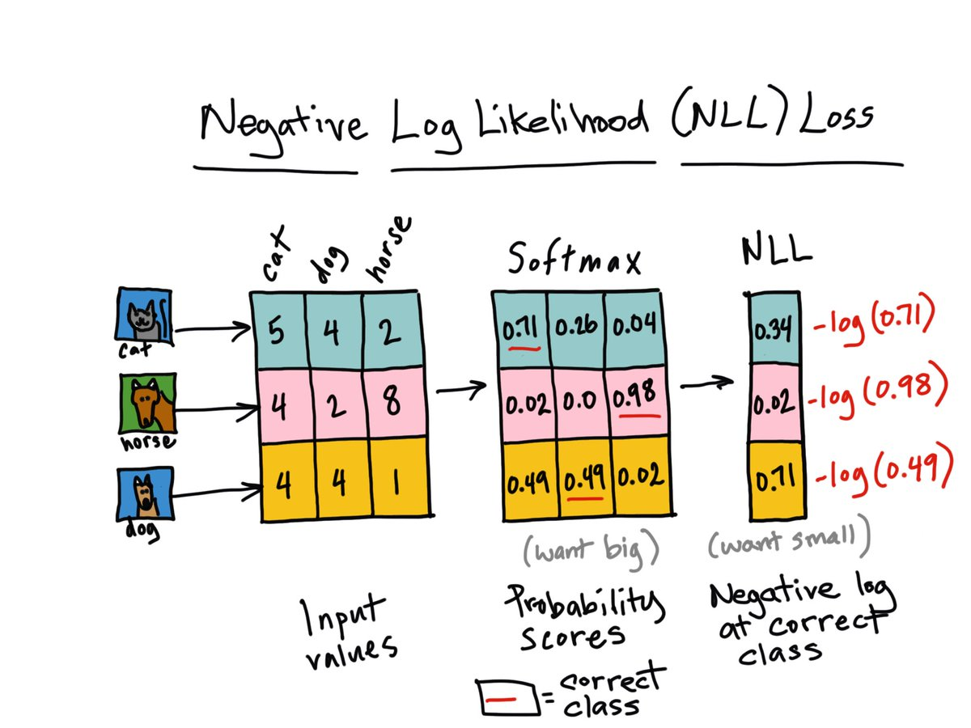

Negative log likelihood loss function, SOFTMAX & ADAM OPTIMIZER
Loss functions define what a good prediction is and isn't a way to measure how well the model is performing.
Optimizers are algorithms or methods used to change the attributes of the neural network such as weights and learning rate (0.003) to reduce the losses.
Adam is the best among the adaptive optimizers in most of the cases. Good with sparse data. a combination of RMSprop and Stochastic Gradient Descent with momentum. It uses the squared gradients to scale the learning rate like RMSprop and it takes advantage of momentum by using moving average of the gradient instead of gradient itself like SGD with momentum.

Slide 23
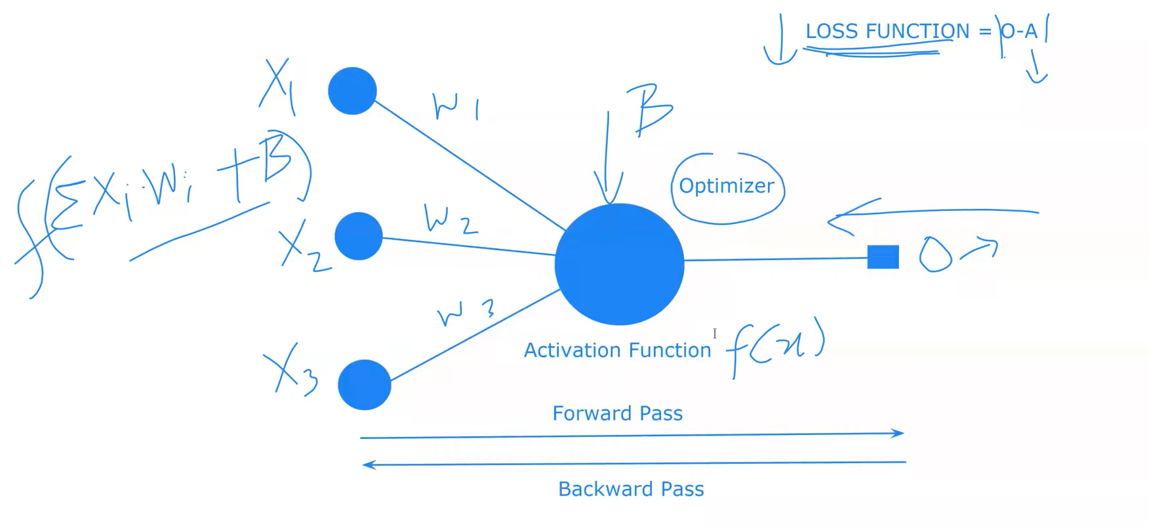

Slide 24
Research Breif
Compared many Augmentation libraries, and chosen the efficient features of it and built an custom augmentation library.
Created a detailed summary of each type of augmentations that the library supports
Developed a Dataset Balance & Unbalance Creator
Built a Augmentation Dataset Creator based on the Augmentation library

Slide 25
Research Breif
Implemented the RESNET18 model
Ran for 100 epochs for each test case [Augmented Dataset ] & choosing the best trained model using the test accuracies
Ran the test cases for 1:2, 1:4, 1:8, 1:16, 1:20 imbalance
Ran the tests for 3 datasets
Analyzed & compared the results to compare the augmentations that improve the model accuracy

Slide 26
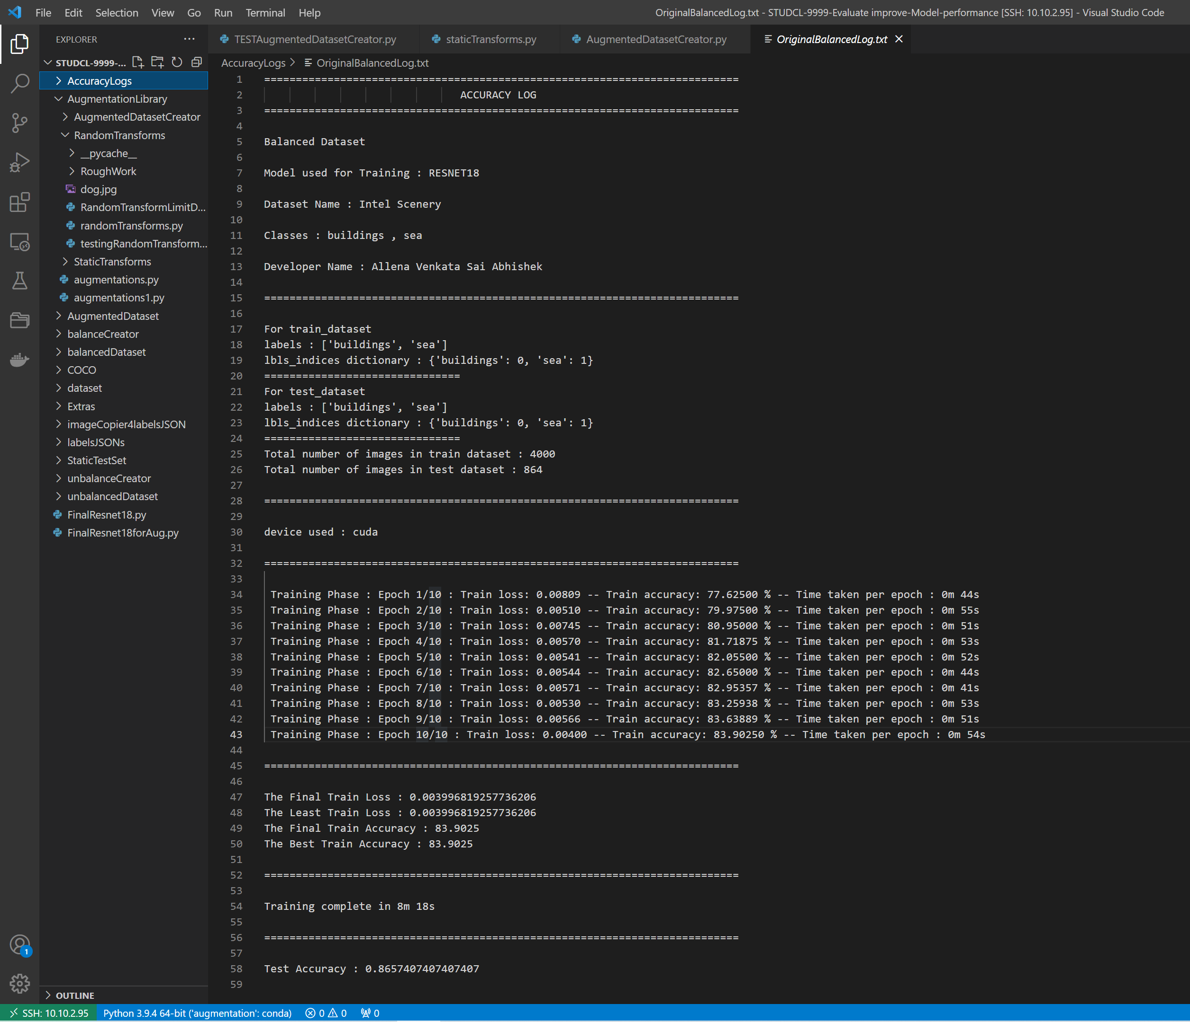
RESULTS?
Finding accuracies on a fixed test set for all the test cases in which we are training using different test cases
Evaluating the model accuracies for each test case saved in accuracy log files
Finding out the best Augmentation techniques that gives the best accuracy for the Intel Scenery Dataset

Slide 27
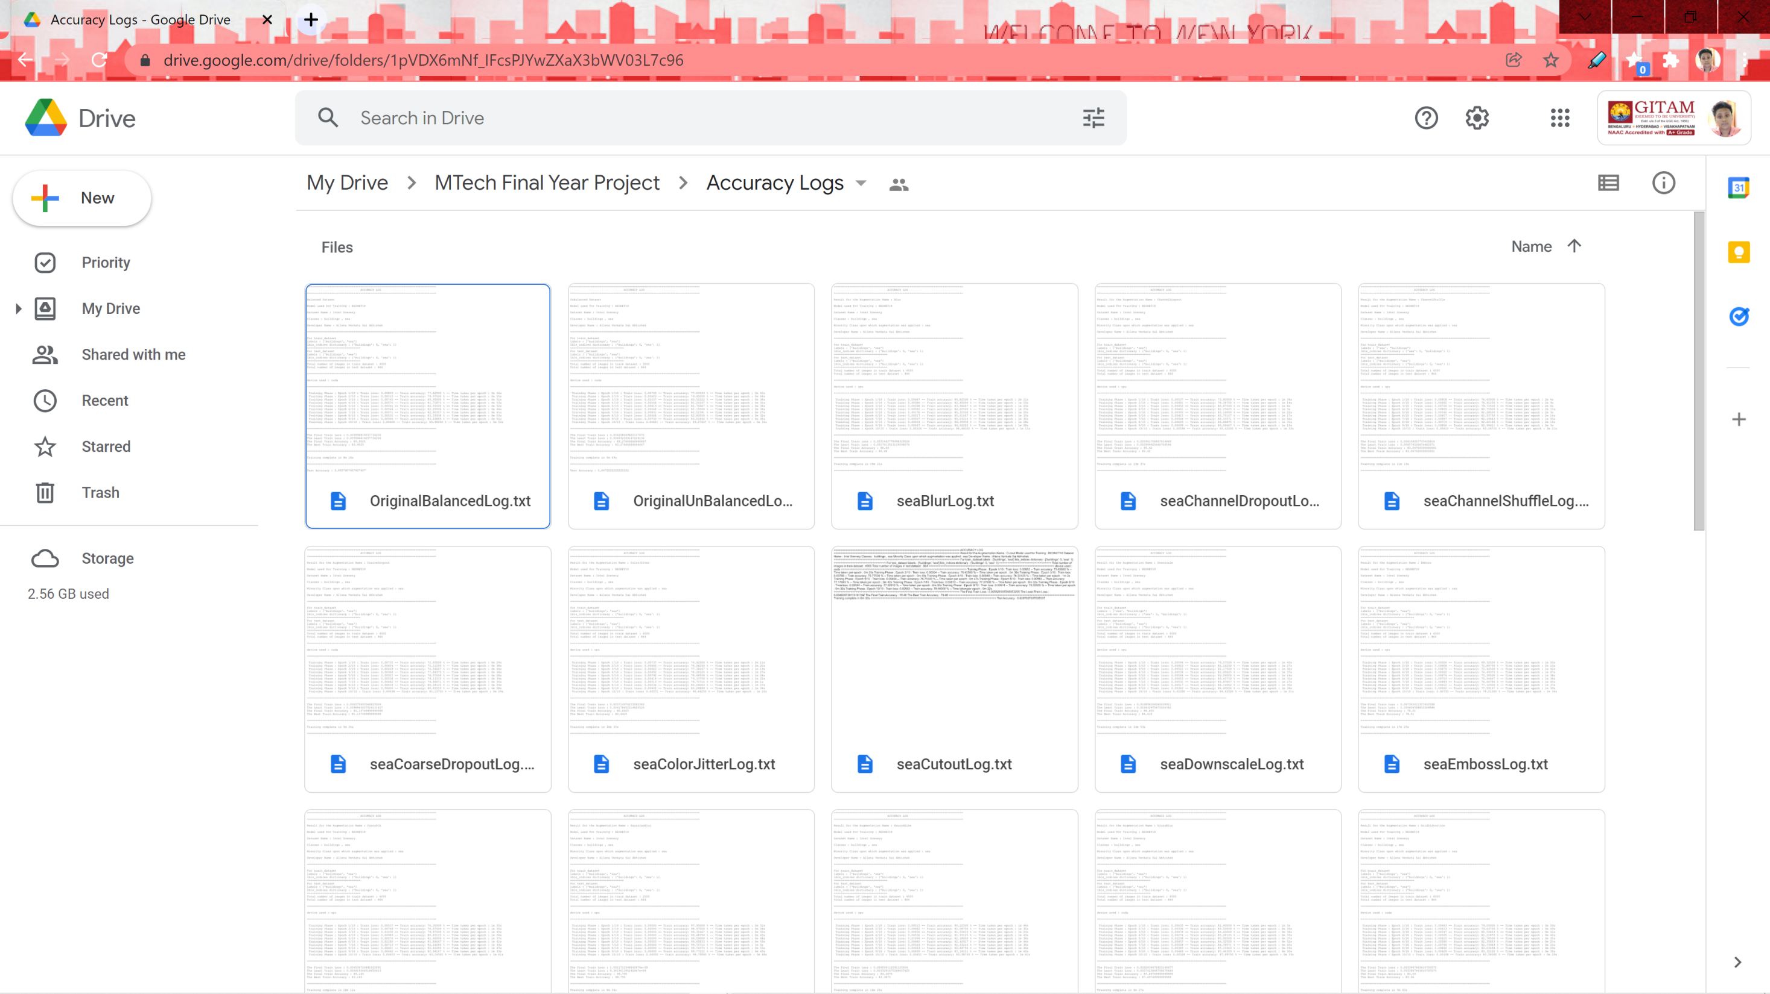
ACCURACY LOGS

Slide 28
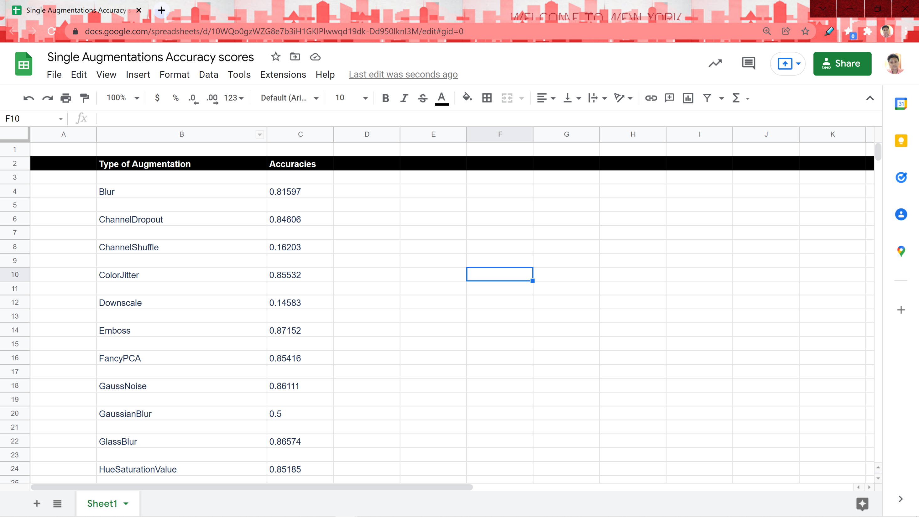
RESULTS OF ACCURACY FOR SINGLE STATIC AUGMENTATIONS

Slide 29
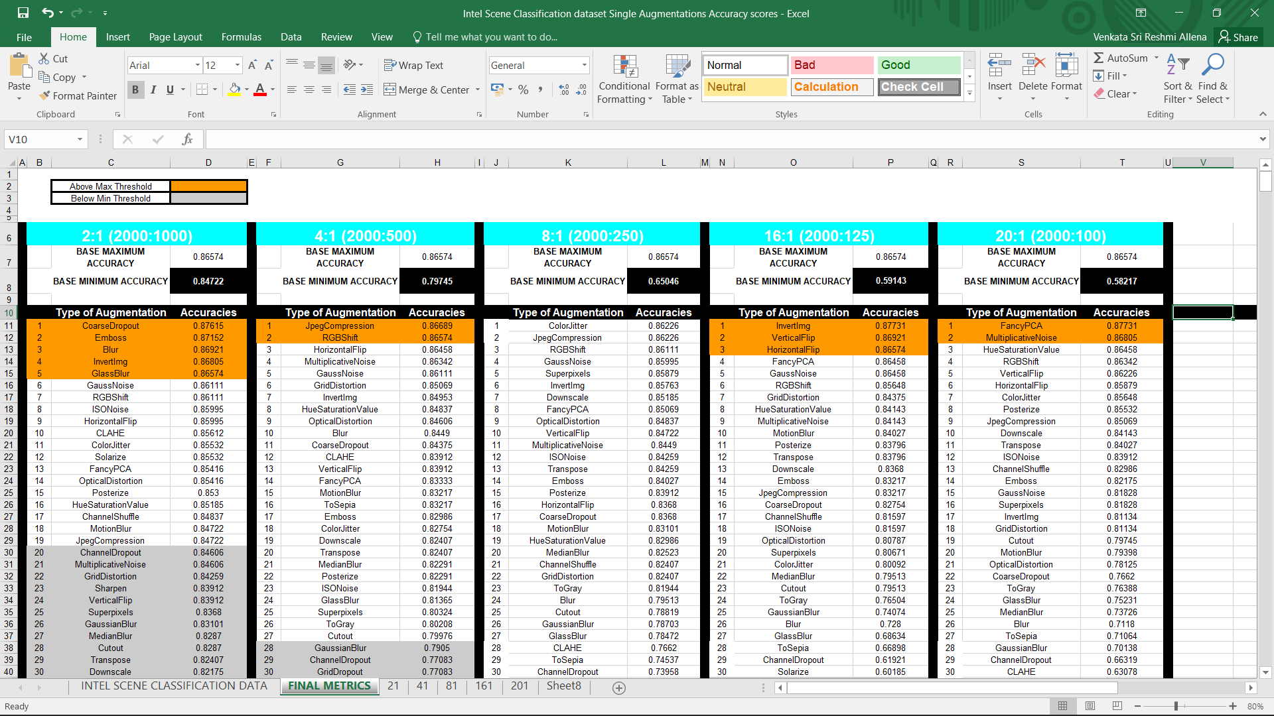

Slide 30
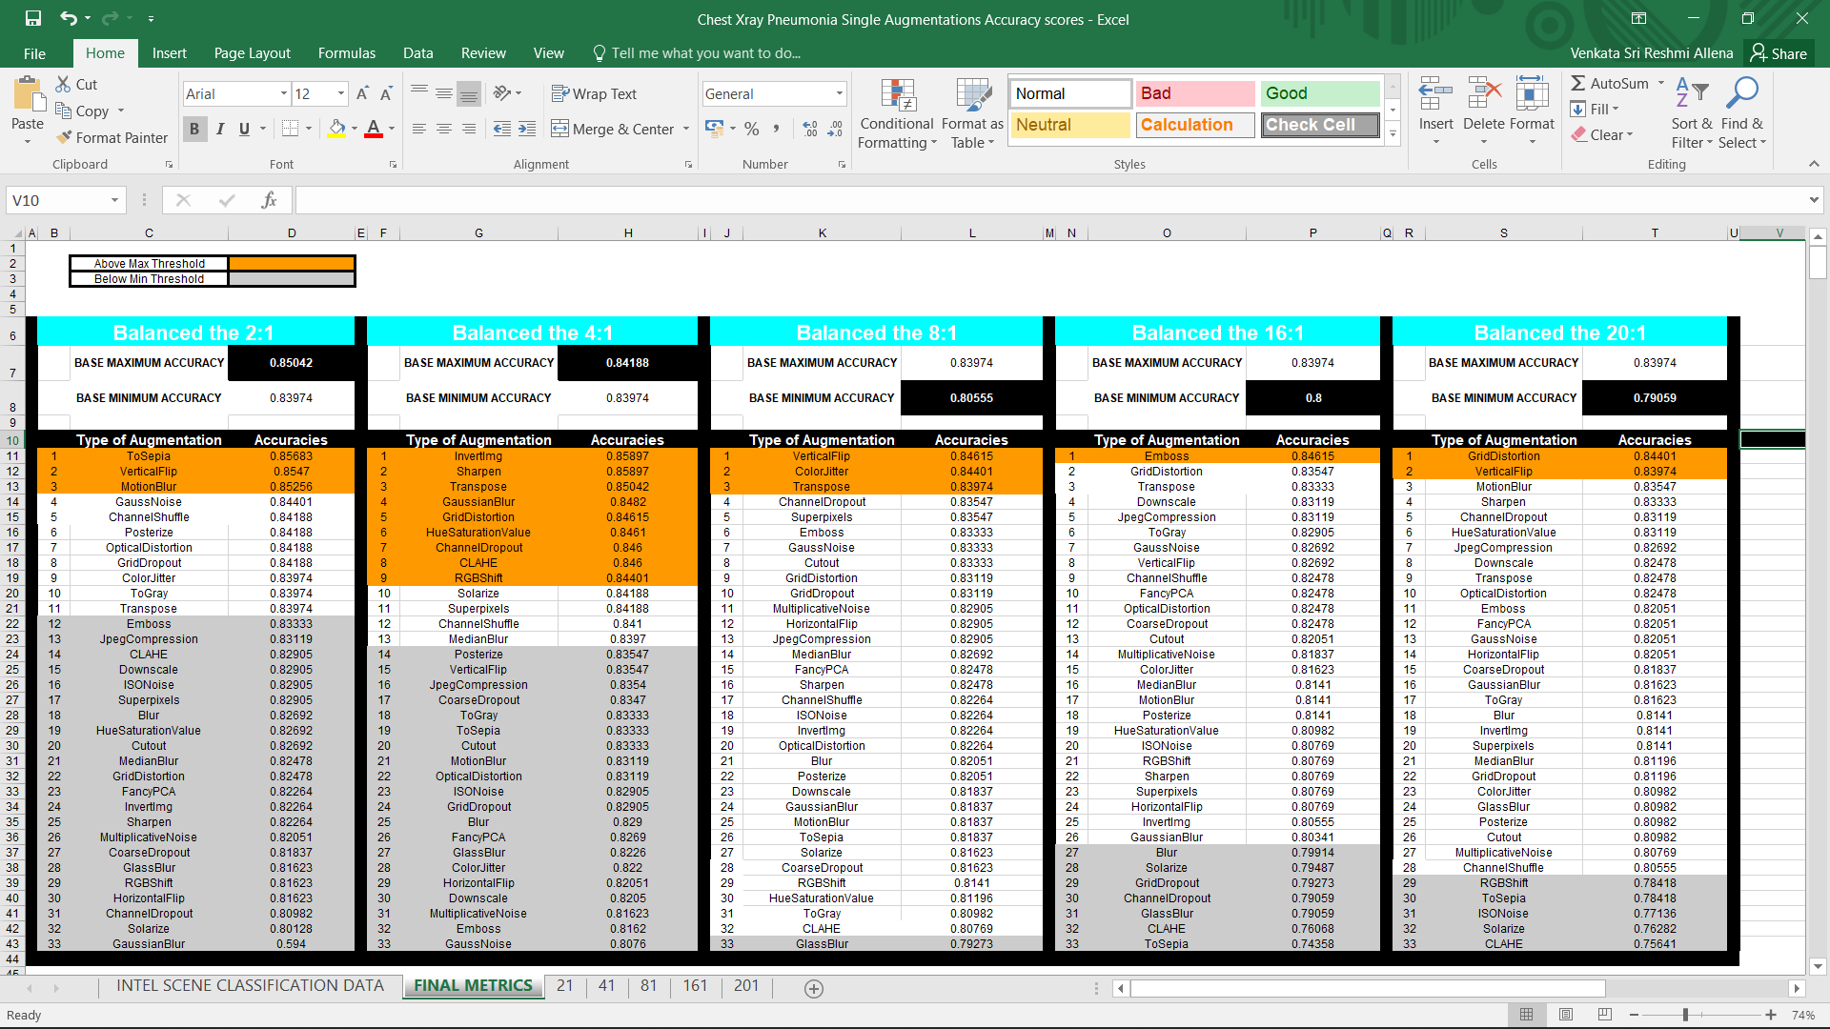

Slide 31
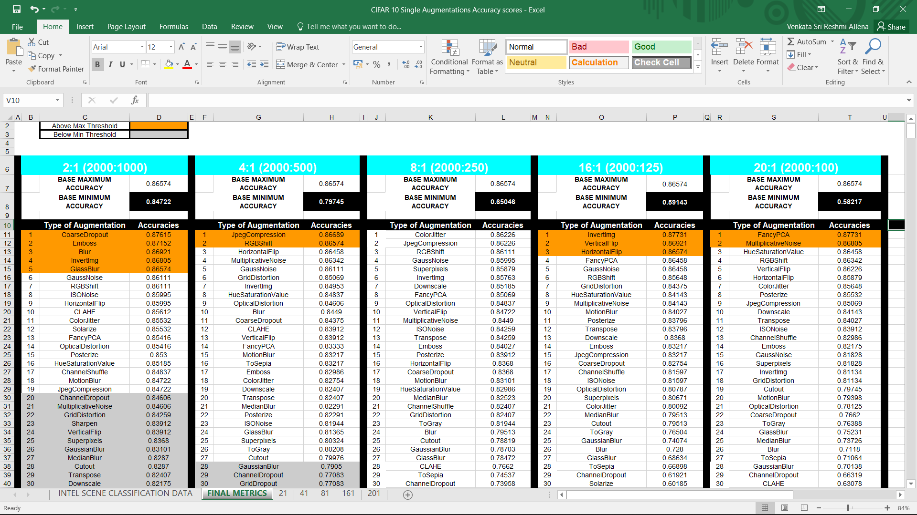

Slide 32
Conclusion
Effectiveness of augmentations techniques for the datasets
For Intel Scene Dataset -
For Chest Xray Pneumonia Dataset -
INEFFECTIVE | EFFECTIVE
GaussianBlur ChannelDropout GridDropout Sharpen Solarize | FancyPCA GaussNoise InvertImg RGBShift HueSaturationValue JpegCompression MultiplicativeNoise
INEFFECTIVE | EFFECTIVE
GaussianBlur Glass Blur ChannelDropout GridDropout Sharpen Solarize | VerticalFlip Transpose GaussNoise MotionBlur HueSaturationValue
For CIFAR 10 Dataset -
INEFFECTIVE | EFFECTIVE
GaussianBlur ChannelDropout GridDropout Sharpen Solarize | FancyPCA GaussNoise InvertImg RGBShift HueSaturationValue JpegCompression MultiplicativeNoise

Slide 33
Future Scope
Augmentation libraries and techniques have improved a lot over the past decade with an exponential increase in data. There is a lot of research going on & few scope for future are to implement additional features such as getting the Random Transformations with the type and parameter values of it, Implementing the Random Augmentations in Augmented Dataset Creator, Getting the Accuracies for Random Augmented Datasets, implementing more cases an combination by using multiple transforms and getting the prediction scores and using the combination of the majority, moderate and lower prediction scores for the augmentation techniques. Then getting the accuracies of each for evaluation. GANs can also be implemented to create the augmented images. Data scientists & ML Engineers can use the system to improve the model to learn more with less data by implementing the effective augmentation for the datasets based on insights derived from this research with further implementation of the research in data augmentation & machine learning. This will help the customers to enhance the business etc.

Slide 34
References
1. A systematic study of the class imbalance problem in convolutional neural networks - Mateusz Buda, Atsuto Maki, Maciej A. Mazurowski ( https://arxiv.org/pdf/1710.05381v2.pdf )
2. Deep Residual Learning for Image Recognition Kaiming He, Xiangyu Zhang, Shaoqing Ren, Jian Sun ( https://arxiv.org/pdf/1512.03385v1.pdf )
3. A survey on Image Data Augmentation for Deep Learning Connor Taghi M. Khoshgoftaar ( https://journalofbigdata.springeropen.com/track/pdf/10.1186/s40537-019-0197-0.pdf )
4. Radial-Based Undersampling for Imbalanced Data Classification Michał Koziarski ( https://arxiv.org/pdf/1906.00452v2.pdf )
5. Augmentor: An Image Augmentation Library for Machine Learning Marcus D. Bloice, Christof Stocker, Andreas Holzinger (https://arxiv.org/pdf/1708.04680.pdf)
6. Albumentations: fast and flexible image Augmentations Alexandr A. Kalinin, Vladimir I. Iglovikov, Eugene Khvedchenya, Alex Parinov, Alexander Buslaev (https://www.mdpi.com/2078-2489/11/2/125)
7. MixUp augmentation for image classification Hongyi Zhang, Moustapha Cisse, Yann N. Dauphin, David Lopez-Paz (https://arxiv.org/pdf/1710.09412.pdf)
8. Learning Data Manipulation for Augmentation and Weighting Zhiting Hu, Bowen Tan, Ruslan Salakhutdinov, Tom Mitchell, Eric P. Xing (https://arxiv.org/pdf/1910.12795v1.pdf )
9. Robust High-Resolution Video Matting with Temporal Guidance Shanchuan Lin, Linjie Yang, Imran Saleemi, Soumyadip Sengupta (https://arxiv.org/pdf/2108.11515.pdf)
10. Robust Retinal Vessel Segmentation from a Data Augmentation Perspective Xu Sun, Huihui Fang, Yehui Yang, Dongwei Zhu, Lei Wang, Junwei Liu, Yanwu Xu (https://arxiv.org/pdf/2007.15883.pdf)
11. The Effects of Class Imbalance and Training Data Size on Classifer Learning Wanwan Zheng, Mingzhe Jin ( https://link.springer.com/article/10.1007/s42979-020-0074-0 )
12. ImageNet Classification with Deep Convolutional Neural Networks Alex Krizhevsky, Ilya Sutskever, Geoffrey E. Hinton ( https://proceedings.neurips.cc/paper/2012/file/c399862d3b9d6b76c8436e924a68c45b-Paper.pdf )
13. Generative Adversarial Networks Ian J. Goodfellow, Jean Pouget-Abadie, Mehdi Mirza, Bing Xu, David Warde-Farley, Sherjil Ozair, Aaron Courville, Yoshua Bengio ( https://arxiv.org/pdf/1406.2661v1.pdf )
14. SMOTE: Synthetic Minority Over-sampling Technique N. V. Chawla, K. W. Bowyer, L. O. Hall, W. P. Kegelmeyer ( https://arxiv.org/pdf/1106.1813v1.pdf )
15. ResNet-like Architecture with Low Hardware Requirements Elena Limonova, Daniil Alfonso, Dmitry Nikolaev, Vladimir V. Arlazarov ( https://arxiv.org/pdf/2009.07190v2.pdf )

Slide 35
SRS (Software Requirement Specification)
Text Editor : VS Code
OS: Windows/Linux/MacOS
Storage Space : 6GB
RAM : 8GB
GPU Required : Advisable, for running the model faster (NVIDIA GPU)

Slide 36
Libraries used
Numpy (For arrays)
PIL (Pillow/Python Image Library)
OpenCV
Tensorflow ( Implement deep learning algorithms, since it allows us to take advantage of GPUs for more efficient training )
Keras (offer simple and consistent APIS & for developing and evaluating deep learning models) [Being a high-level API on top of TensorFlow, we can say that Keras makes TensorFlow easy. ]
Matplotlib
Sys
Torch ( Version - '1.10.0')
Pytorch (For using inbuilt transforms)
Pprint
Os
Random
Pandas (If need to store data in CSV etc)
JSON ( storing the data generated in a JSON etc )
Albumentation (Using transforms)
Glob
Shutil

Slide 37
THANK YOU

